Slide 1

Quantifying the Complexity of Cardiac System Simulation by analyzing APD sequence
Xiaodong (Will) AN

Slide 2
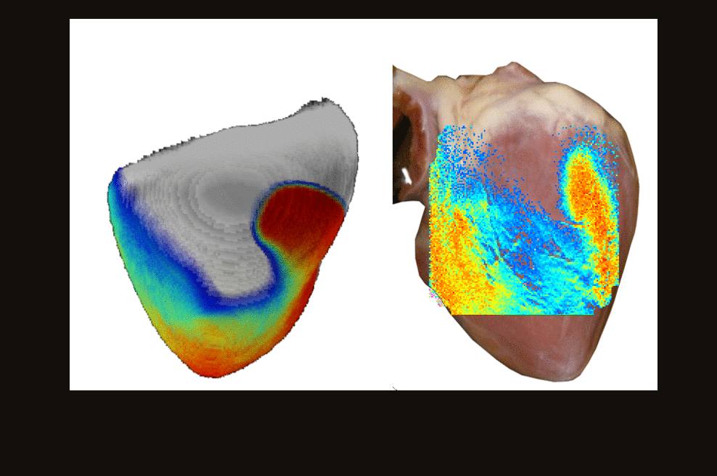
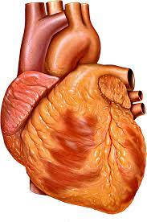
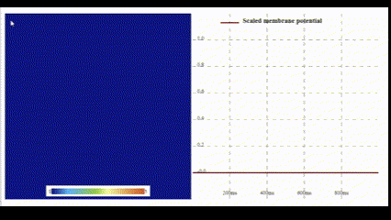
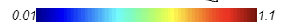
Contents
Introduction
Method (Literature Review)
Current Result and Future Work
Conclusion
Wave propagating
(simulation)

Slide 3
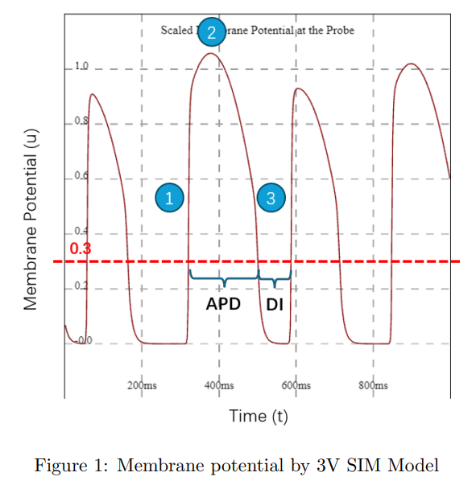
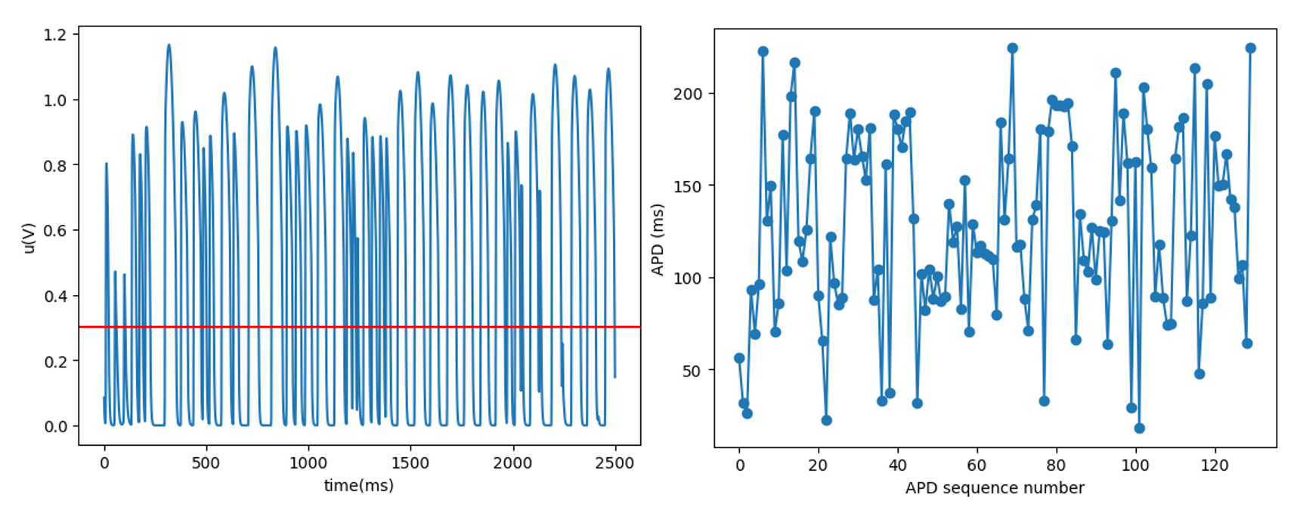
Introduction
This research tries to do these things:
1. Quantify the complexity of cardiac system simulations with parameter changing
2. Quantify simulations with meandering cases.
3. Quantify experimental results that have noise.
With determination of the chaotic and non-chaotic regions for different parameters, it can guide the cardiac medication to avoid deadly chaos and help us understand the cardiac model more.
70

Slide 4
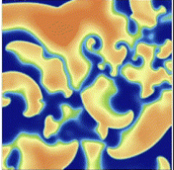
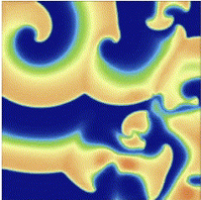
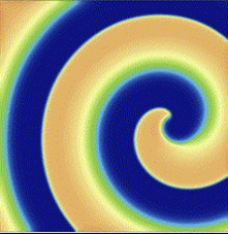
Introduction – Chaos Quantification
They have different complexities, but how do we quantify them?

Slide 5
Introduction – Chaos Quantification
There are several approaches for chaos quantification, including leading Lyapunov exponent (Characteristic exponent), Correlation dimension, and return map.
Lyapunov exponent: Quantification of the exponential growth rate in phase space.
Correlation dimension: The dimension of the strange attractors in phase space.
Return map: Visualization of complexity.

Slide 6
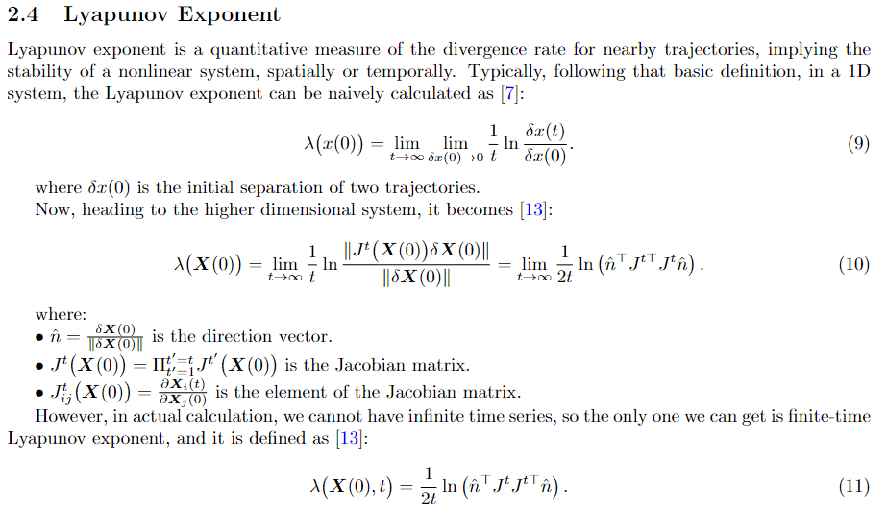
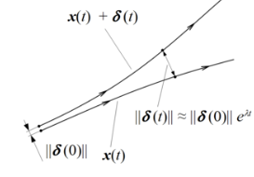
Introduction – Lyapunov Exponent (LE)

Slide 7
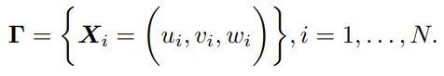
Introduction
Guide us to avoid deadly chaos and understand the cardiac model more.
Simulation: 3V SIM Model
Complexity (LE)
0.3
0.15
0.01
Quantify Methods (LE)

Slide 8
Method
3V SIM Model
Lyapunov Exponent:
Phase Space Reconstruction
Wolf’s Algorithm
Spatial-Temporal Algorithm
Noise and Chaos Distinguishment

Slide 9
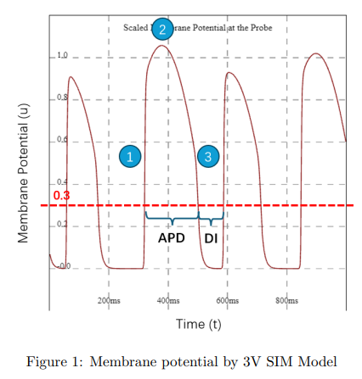
Method – 3V SIM Model
3V SIM model or Fenton-Karma Model was developed in 1990s and it quantitatively reproduced APD vs DI curve (restitution curve) which determines the APD and relevant propagation velocity after repolarization.
Three variables: u,v,w
Three currents: I_fi (Na+), I_si (Ca2+), I_so (K+)

Slide 10
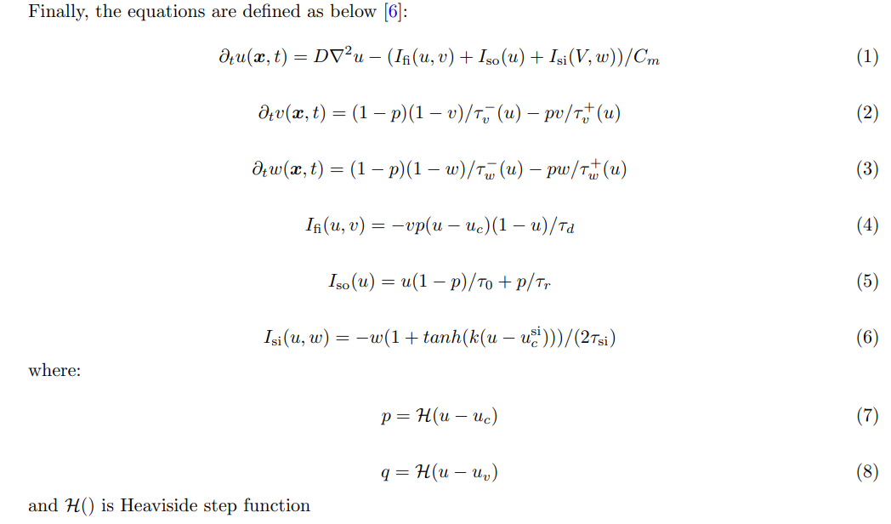
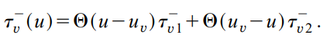
Method – 3V SIM Model

Slide 11
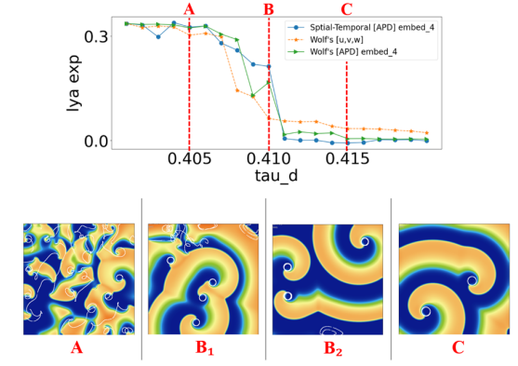
Method – 3V SIM Model
Qualitatively, I (Na+) = v / tau_d.
So, we can regard tau_d as the resistance of the sodium current
In later section, I discussed the different complexity by changing tau_d

Slide 12
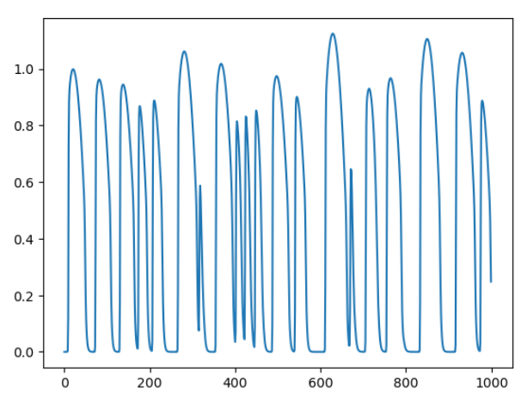
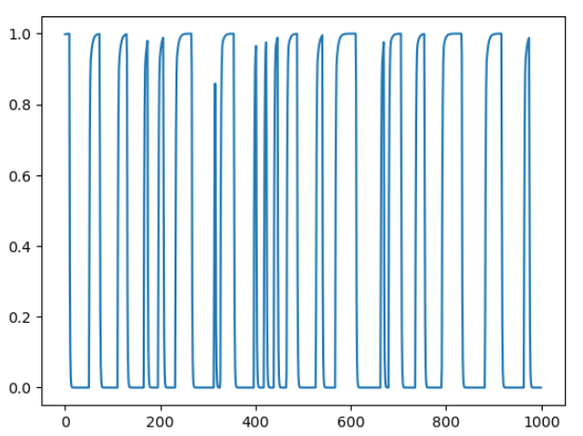
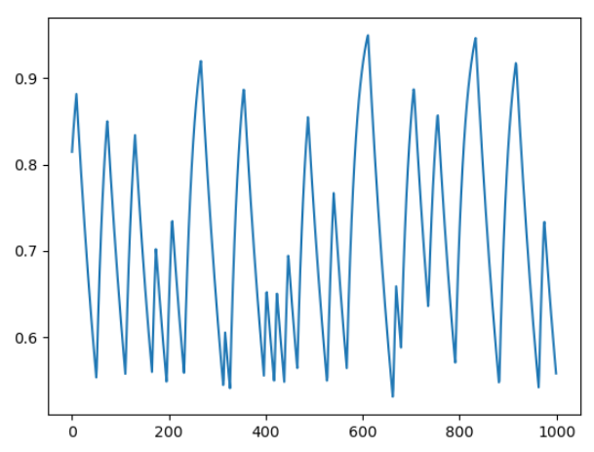
Method – LE (full phase space)
We can input the full phase space (all variables) into Algo, and get LE.
Complexity (LE)
0.01
u
v
Quantify Methods (LE)
0.15
w
0.3

Slide 13
Method – LE (APD)
We can also input the APD into Algo, and get LE.
With less data needed, but nonlinear property retained.
Complexity (LE)
0.01
f(u):
APD
Quantify Methods
0.15
Phase space reconstruct
0.3

Slide 14
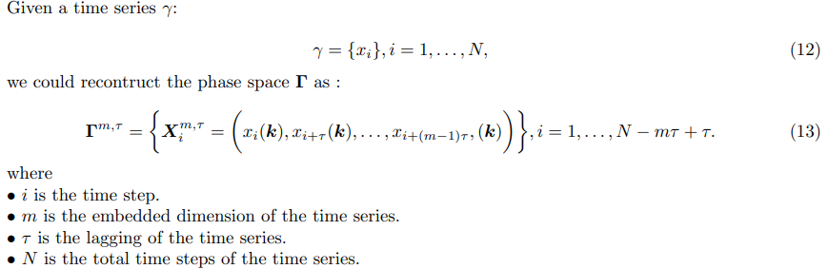
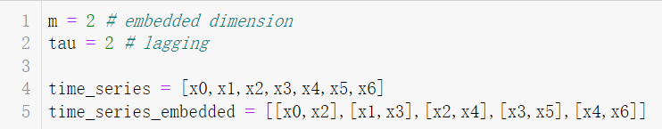
Method – Taken’s Theorem
Limited observations of state variables can retain the Lyapunov exponent by proper lag-embedding.

Slide 15
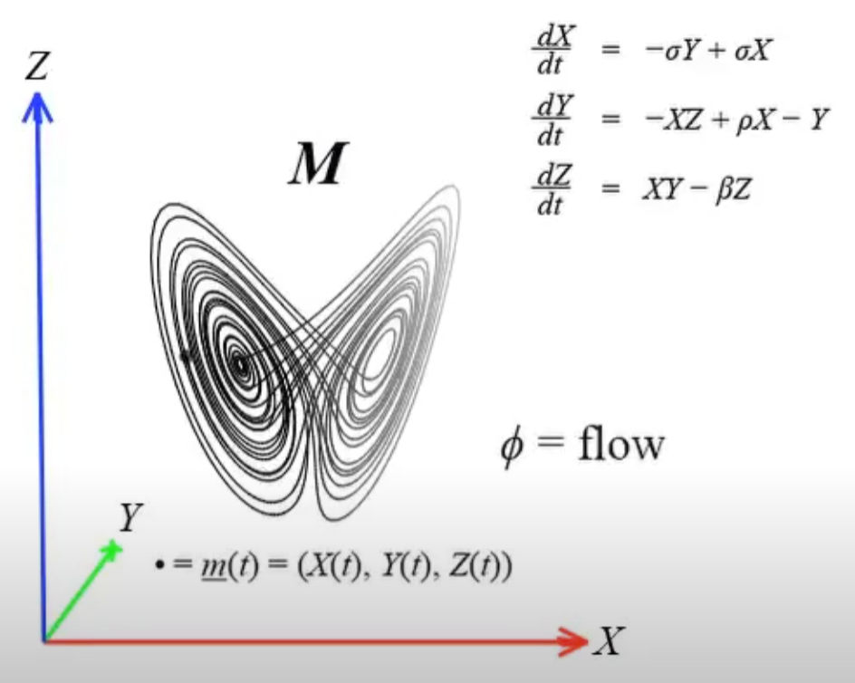
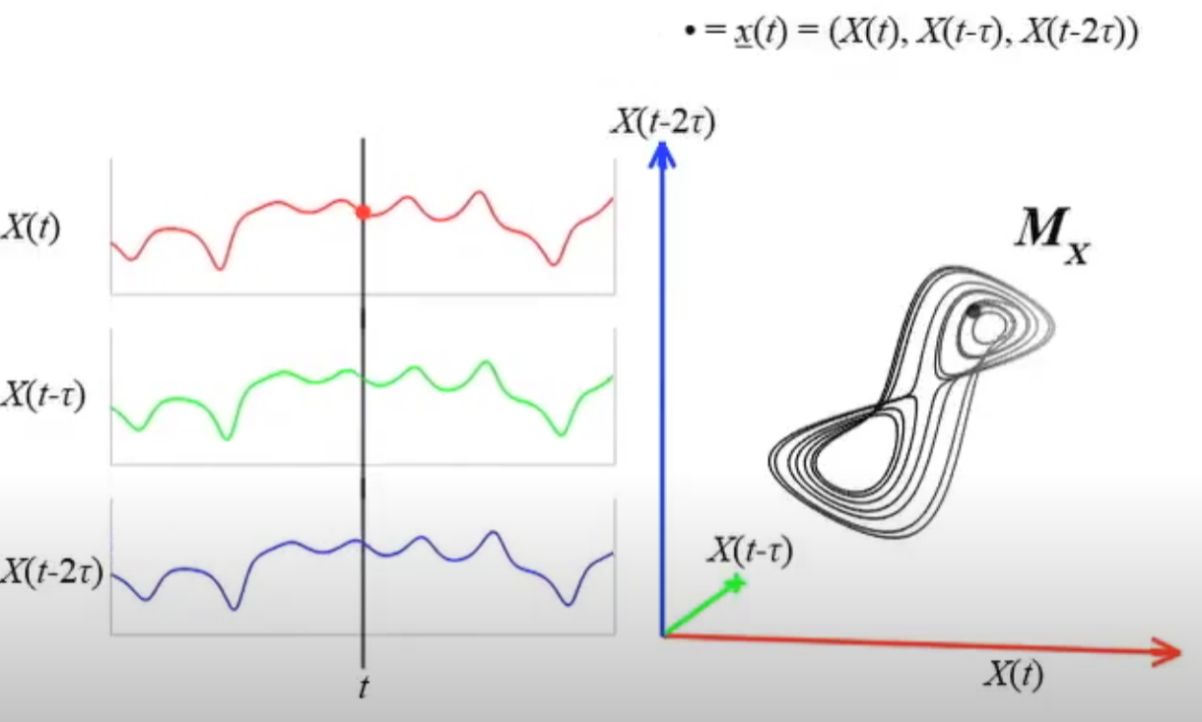
Method – Taken’s Theorem
https://www.youtube.com/watch?v=6i57udsPKms&t=40s
Sugihara, George, et al. "Detecting causality in complex ecosystems." science 338.6106 (2012): 496-500.

Slide 16
Method – Taken’s Theorem (lagging τ)
To get the proper embedding, we decide lagging τ first and then dimension m.
Embeddings with the same m but different τ are equivalent in the mathematical sense for noise-free data [15]. Therefore, for the purposes of this research, where simulations are conducted without the influence of noise, a simple choice of τ = 1 is sufficient.

Slide 17
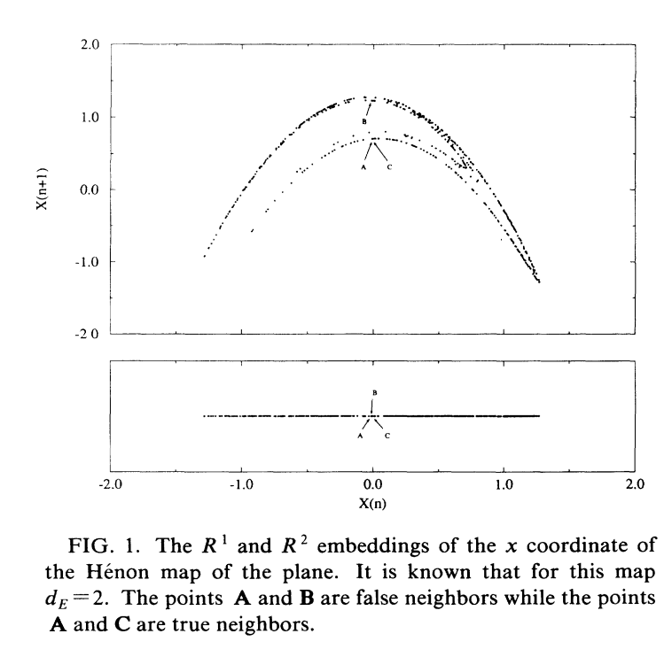
Method – FNN
For embedded dimension m, there are methods including False Nearest Neighbor (FNN) method [21].
Unwanted “crossing” in 2d projection, or a pair of false neighbors
Autonomous system
(Uniqueness)
Kennel, Matthew B., Reggie Brown, and Henry DI Abarbanel. "Determining embedding dimension for phase-space reconstruction using a geometrical construction." Physical review A 45.6 (1992): 3403.

Slide 18
Method – FNN
The optimal dimension is found when percentage of FNN is dropped to a very low value
Unwanted “crossing” in 2d projection, or a pair of false neighbors
Autonomous system
(Uniqueness)
Kennel, Matthew B., Reggie Brown, and Henry DI Abarbanel. "Determining embedding dimension for phase-space reconstruction using a geometrical construction." Physical review A 45.6 (1992): 3403.

Slide 19
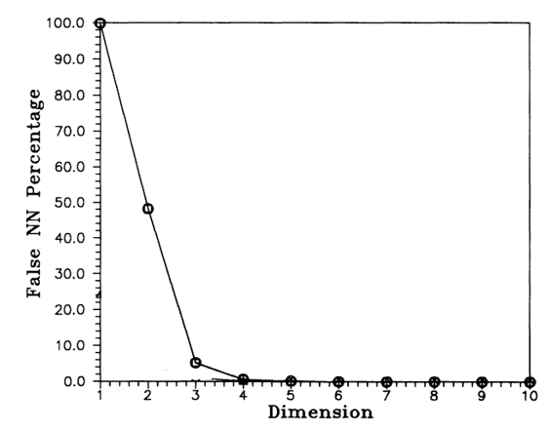
Method – FNN
FNN for Lorentz Attractors

Slide 20
Method – FNN
Uniqueness except for this

Slide 21
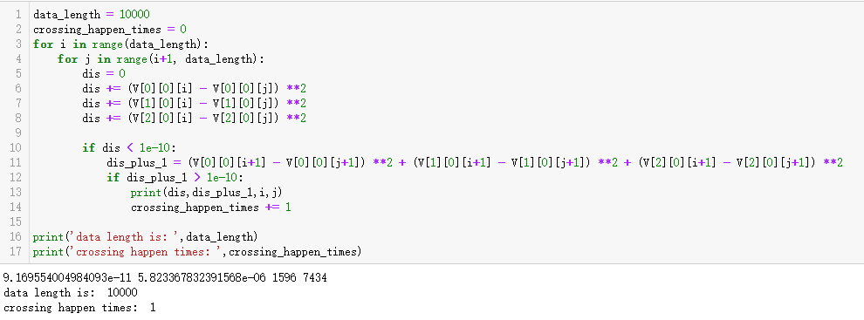
Method – FNN
Even with the Laplacian term, there is only 0.01% crossing in true phase space. So, FNN can work for 3V SIM Model with error of O(1e-4)

Slide 22
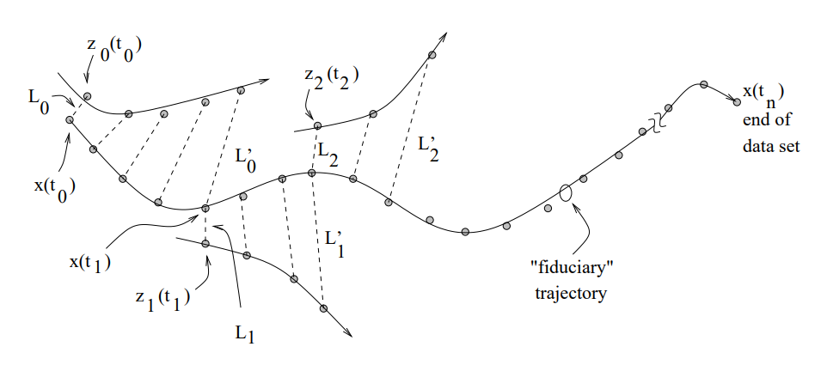

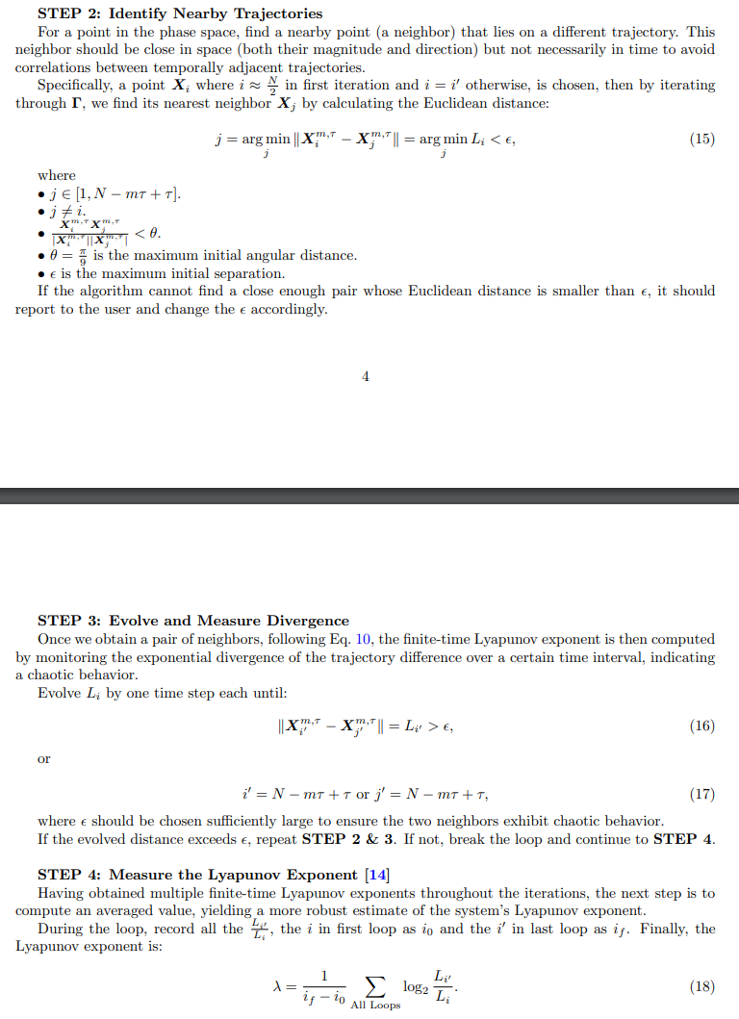
Method – Wolf’s Algo
Step 1: data prepare (original phase space or phase space reconstruction)
https://home.cs.colorado.edu/~lizb/chaos/wolf-notes.pdf

Slide 23
Method – Wolf’s Algo
https://home.cs.colorado.edu/~lizb/chaos/wolf-notes.pdf

Slide 24
Method – Wolf’s Algo
average
https://home.cs.colorado.edu/~lizb/chaos/wolf-notes.pdf

Slide 25
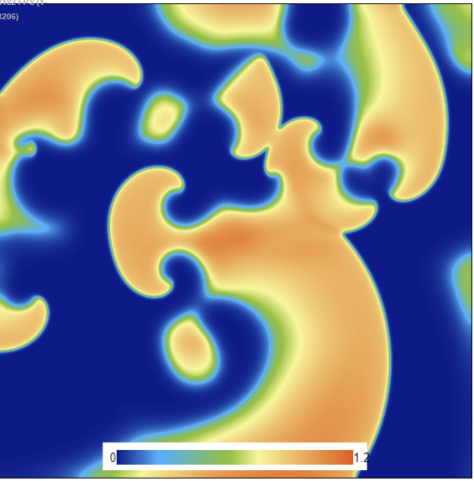
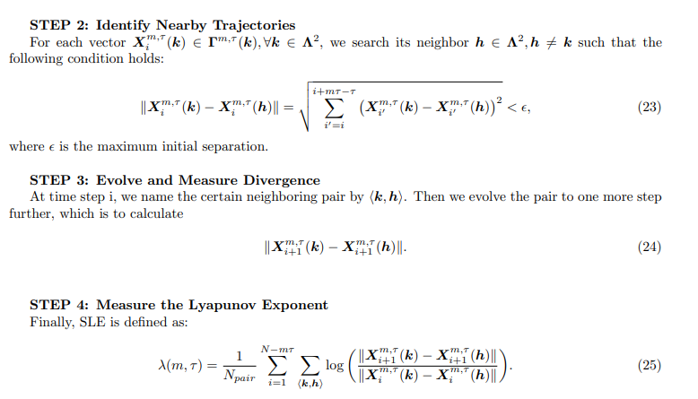
Method – Spatial Temporal LE (SLE)
Step 1: data prepare (original phase space or phase space reconstruction)
k
h

Slide 26
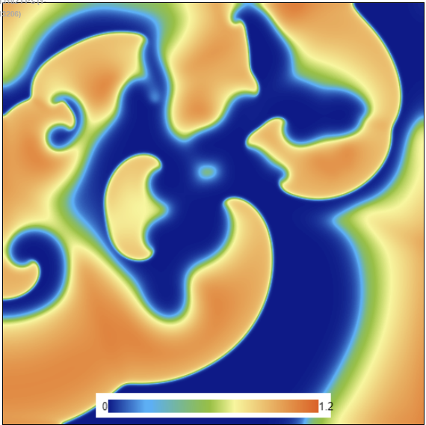
Method – Spatial Temporal LE (SLE)
k
k
h
After duration 1
→ → → →
h

Slide 27
Method – Spatial Temporal LE (SLE)
k
k'
k
k'
h
After duration 1
h'
→ → → →
h
h'

Slide 28
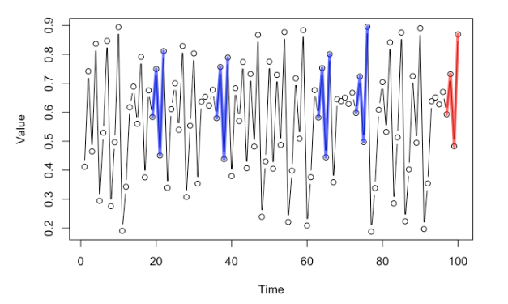
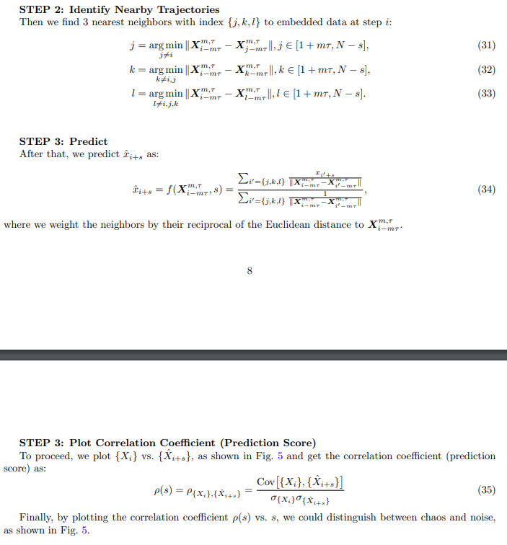
Method – Noise Chaos distinguishment
Simplex Projection
Embed_dim = 4, tau = 1
Step 1: data prepare (original phase space or phase space reconstruction)
l
m
k
j
m = ~

Slide 29
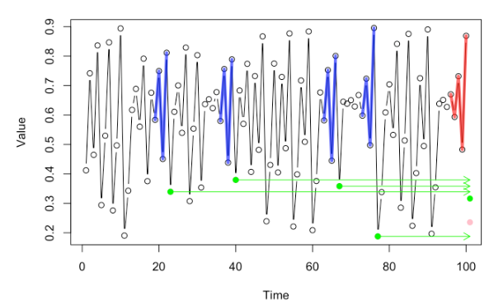

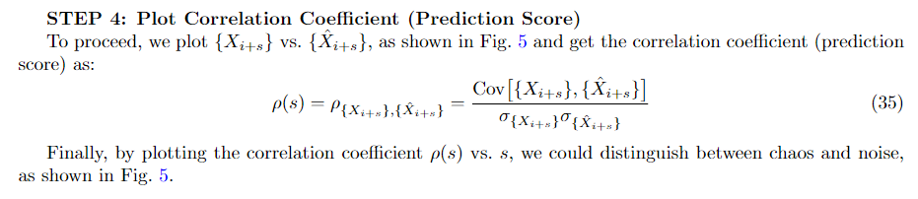
Method – Noise Chaos distinguishment
Simplex Projection

Slide 30
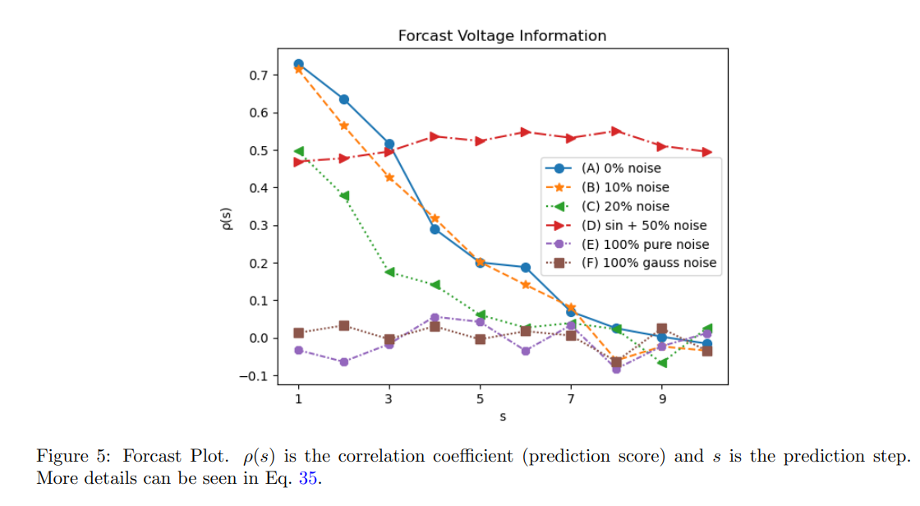
Method – Noise Chaos distinguishment
Unautocorrelated noise would not be predicted by similar patterns since its next data point is not correlated with current pattern.
We can expect the chaos has decreasing prediction score with increasing prediction steps. But noise just keep a flat line.

Slide 31
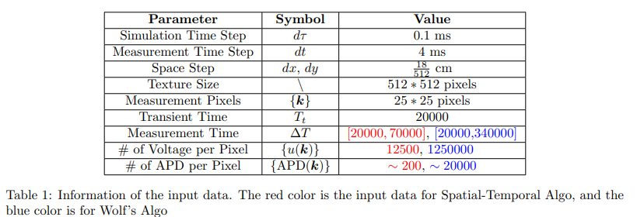
Method - Simulation
We take advantage of fast GPU simulations using webGL.
https://abubujs.org/ (Dr. Abouzar Kaboudian)
It can run real-time simulation on PC, tablet and even cell phone.
Wave propagating
(simulation)

Slide 32
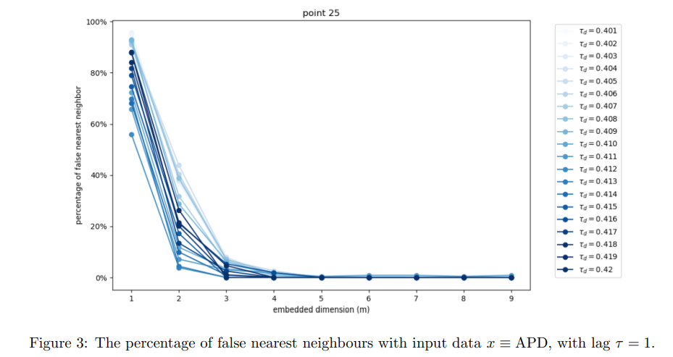
Current Result and Future Work – FNN
Now, by plotting the FNN percentage with respect to m, we get optimal m when it no longer decreases
Minimum crossings happen

Slide 33
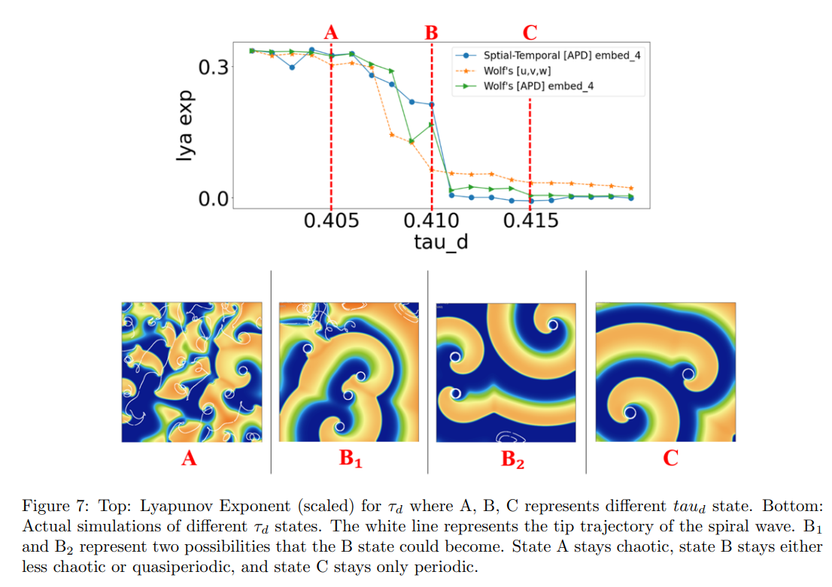
Current Result and Future Work
For tau_d, which is the resistance of Na+, I quantified the chaos, which qualitatively match with the simulation map.
Demo: https://chaos.gatech.edu/eaav6019/files/2D-3V-Model/index.html

Slide 34
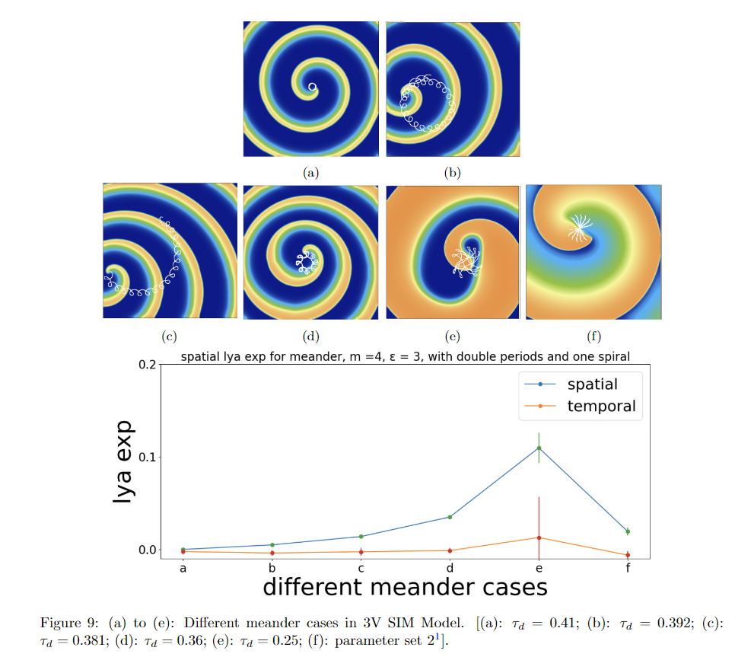
Current Result and Future Work
Quantification of more complex models/patterns
For example, here is the LE for different tip meandering cases.
Notice here “temporal” used TISEAN (Nonlinear Time Series Analysis)

Slide 35
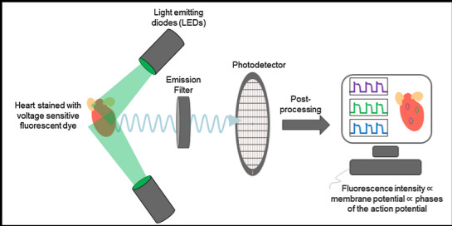
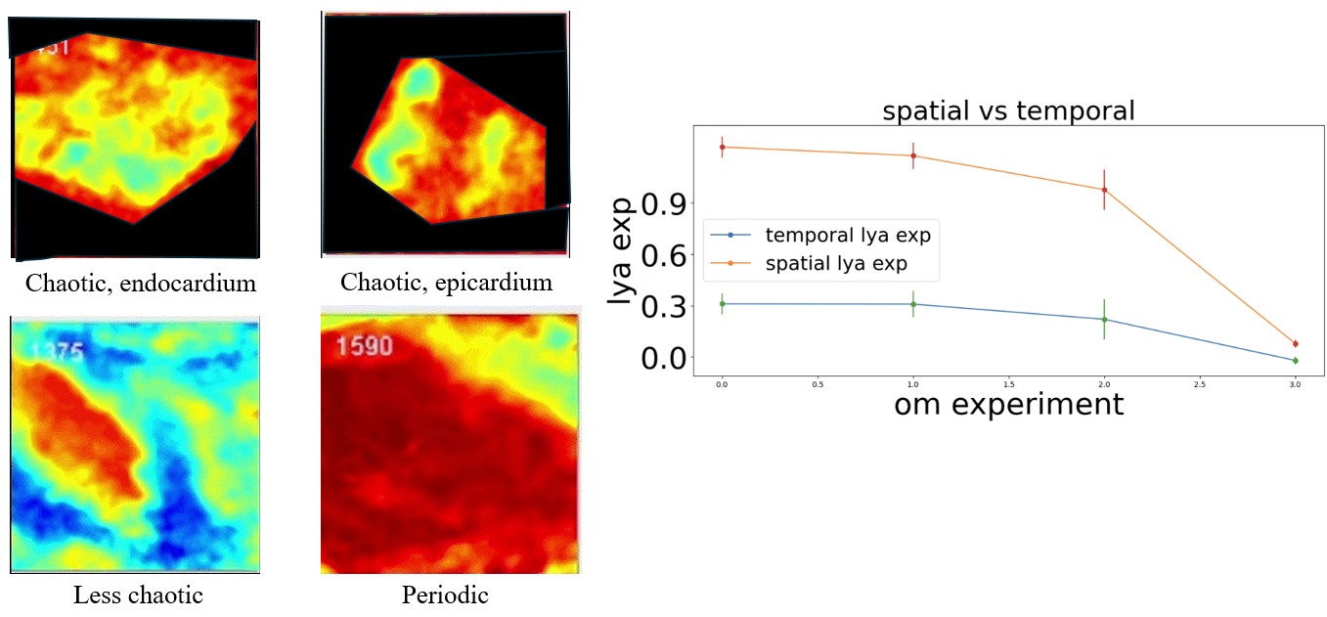
Current Result and Future Work
Quantification of experimental results.
For example, here is the LE for pig hearts.

Slide 36
Conclusion
The 3V SIM Model is a simplified cardiac model, retaining essential activation and inactivation characteristics while having fewer variables.
I showed that APD data could be alternative choice for determining the Lyapunov exponent.
What’s more, integrating spatial information with the Spatial-Temporal Algorithm could significantly reduce the amount of APD data needed, enabling quicker and even real-time determination of the Lyapunov exponent.
It can help drug development by showing which particular region of parameters are sensitive and likely to induce chaotic behavior.

Slide 37
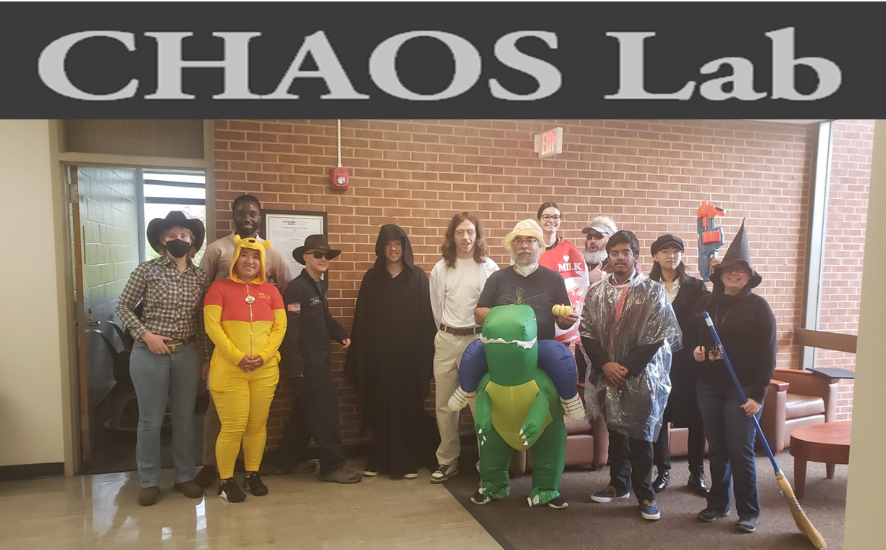
Thanks to CHAOS Lab!
Current Members:
Casey
Evan
Henry
Jimena
Lynn
Mikael
Mikhail
Will
Flavio (Adviser)

Slide 38
Any Question?

